Slide 1
ALASKA’S OIL & GAS INDUSTRY
Cook Inlet Overview & Activity Update
Commonwealth North
Presented by:
Mark Wiggin, Deputy Commissioner
Alaska Department of Natural Resources
June 8, 2017
1

Slide 2
OVERVIEW
Cook Inlet Activity Overview:
Division of Oil and Gas
Resources and Reserves
Current Activity & New Developments

Slide 3
Division of Oil and Gas
Cross disciplinary team:
Scientists
Engineers
Land managers
Economists
Manages 24.7 million acres of world class resources:
Beaufort Sea
North Slope
North Slope Foothills
Cook Inlet
Alaska Peninsula
Over 4 million acres under lease

Slide 4
Oil and Gas Functional Organization Chart

Slide 5
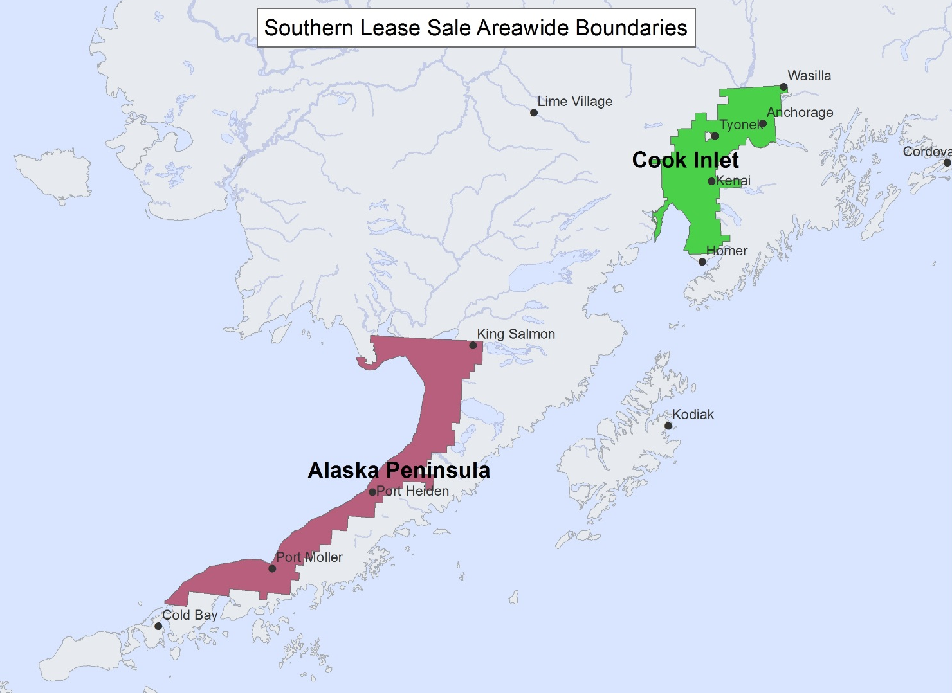
Southern Lease Sales
Spring 2016:
No bids were received for the 2016 Cook inlet and Alaska Peninsula areawide lease sale.

Slide 6
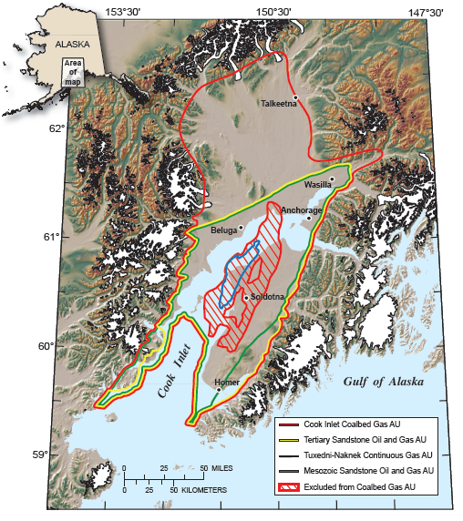
COOK INLET RESOURCE & RESERVES OVERVIEW
Undiscovered, Technically Recoverable Oil & Gas (USGS, 2011):
mean conventional oil 599 MMBO
mean conventional gas 13.7 TCF
mean unconventional gas 5.3 TCF
Natural Gas Reserves (ADNR 2015)
1.18 TCF (Proved + Probable)
1.2 TCF additional mean resource assessed in OCS waters (BOEM, 2011)

Slide 7
COOK INLET
Current Activity & New Developments
Conoco Phillips
Sale of Gas Plant
Transferred North Cook Inlet Unit to Hilcorp
Furie Operating Alaska
Kitchen Lights Unit:
BlueCrest Energy, Inc.
Cosmo Unit: Restarted production March 2016; plans to drill up to 3 wells
Cook Inlet Energy
Continued production from North Fork, Redoubt, and West McArthur River Units

Slide 8
COOK INLET
Current Activity & New Developments
Hilcorp Alaska, LLC:
13 State managed units in Cook Inlet
Cannery Loop Unit:
Completed 1 workover in 2016, plan 1 workover and one sidetrack in 2017
Deep Creek Unit:
Stratigraphic test wells planned for 2017
Granite Point Unit:
Plan 3 side tracks
Ninilchik Unit:
Drilled two new gas wells in 2016 and plan 1 additional in 2017
Trading Bay Unit:
11 workover jobs and 4 sidetracks in 2016, 4 more sidetracks and 3 new wells in 2017

Slide 9
COOK INLET
Recently Issued Seismic permits
Global South Kenai 2D
Requested 50 linear miles
SAE Shadura 3D and 2D
Requested 16 square miles
Requested 42 linear miles
SAE Lower Cook Inlet 3D Marine (2015)
Requested 547.8 square miles
SAE Upper Cook Inlet 3D (2015)
Requested 821 square miles

Slide 10
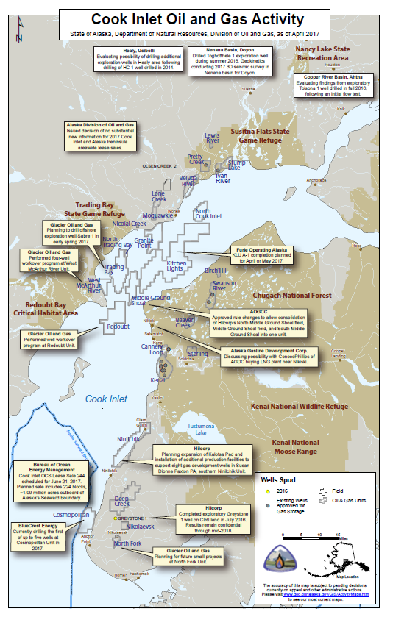

Slide 11
WHO’S WORKING COOK INLET?
Mid-Sized Independents:
Hilcorp Alaska, LLC
Small Independents & LLCs:
AIX Energy LLC
BlueCrest Energy Inc.
CIRI Production Company
Chugach Electric Association
Cook Inlet Energy LLC
Cornucopia Oil & Gas Company LLC
Corsair Oil & Gas Company LLC
Furie Operating Alaska LLC
Municipality of Anchorage dba Municipal Light and Power
Taylor Minerals LLC

Slide 12
Thank You
Questions?

