Slide 3
State Permitting and Survey Strategies
By Dr. Richard VanderHoek

Slide 4
SCRIP Permit
Survey and Testing
Deep Testing

Slide 5
Permitting Legal Framework
The issuance of State Cultural Resource Investigation Permits (SCRIPs) for historic, prehistoric, and archaeological investigations (surveys) on state lands is authorized under AS 41.35.080 and 11 AAC 16. 30-90.
Paleontological resources (“fossils”) are considered archaeological resources under AS 41.35.230(2).
Notes:
Alaska Statute 41.35.080, State Regulations 11 AAC 16.30-90
As archaeologists we tell the public “we don’t do dinosaurs”, but, humorously enough at OHA, we do do dinosaurs.

Slide 6
When do you need an Alaska State Cultural Resource Investigative Permit (SCRIP)?
When you are on state-owned land,
including intertidal and subtidal land, or
state-managed land.
Examples: Lands owned or managed by DOT&PF, DNR/DPOR, DMLW or Forestry, F&G, etc.

Slide 7
How long are permits good for?
Commercial Survey Permit: one year
Monitoring Permit: one year
Academic/Research Survey Permit: may be issued for up to three years, with a possible three-year extension

Slide 8
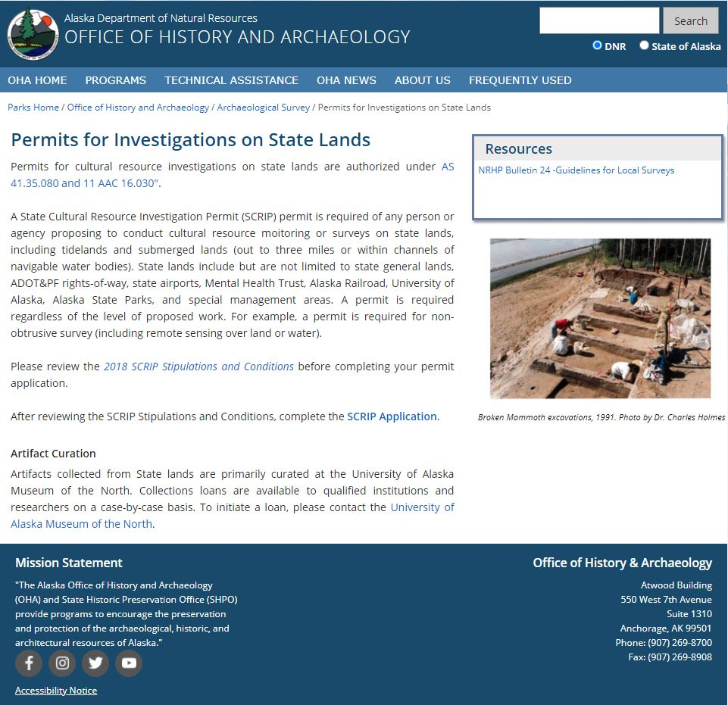
OHA Website: Permits for Investigations on State Land
http://dnr.alaska.gov/parks/oha/archsurv/permitinvestigate.htm
SCRIPS Application

Slide 9
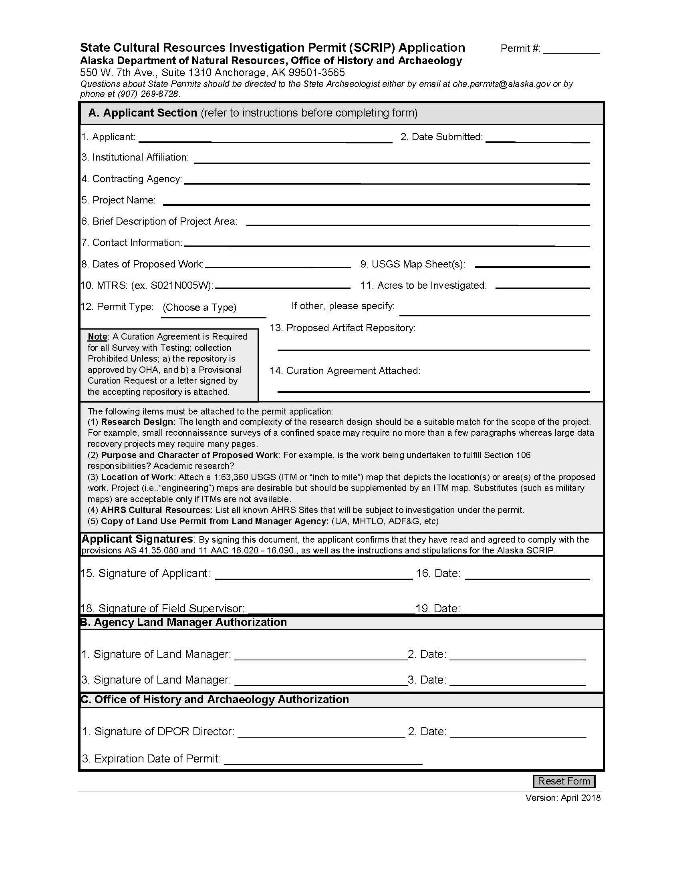
Alaska SCRIP (State Cultural Resources Investigative Permit)

Slide 10
Alaska SCRIP A. Applicant Section:

Slide 11
Filling out your SCRIP
Your SCRIP form is your contract with the State for who will be responsible for the survey and associated report, where these activities will take place, and how any cultural materials will be curated.
Like any contract, the information in the contract needs to be accurate and appropriate for the document.
A common cause of delay in permit processing is inappropriate or inaccurate information on the SCRIP.

Slide 12
Your Permit Must Have:
Item #1. Applicant:
The permit should have a single applicant.
This individual is responsible for following state guidelines for the survey/monitoring and for producing a final report that meets state standards.

Slide 13
Your Permit Must Have:
Item #2: Date:
The date should be roughly analogous to the date the permit was submitted, not two or three weeks previous.

Slide 14
Your Permit Must Have:
Item #7 Contact Information
Please give email, mailing address and phone numbers

Slide 15
Your Permit Must Have:
Item #8 Dates of Proposed Work:
Try to be accurate, yet give yourself plenty of time.
Start your work time-window for some period after your permit submittal. Land managers have refused to sign SCRIPS with work starting dates of before they received the permit request.

Slide 16
Your Permit Must Have:
Item #10 MTRS’s:
Accurate MTRS’s (Meridian, Township, Range, Section) either on the SCRIP or in the research design.
Land managers have refused to sign SCRIPS with inaccurate MTRS’s.
Please note that the Applicant is responsible for identifying specific state land managers (DMLW, DOT&PF, F&G, etc.) for specific MTRS’s for lands to be surveyed. If the survey includes multiple land managers, the list of land managers and corresponding MTRS’s should be included in a separate table in the Research Design.

Slide 17
Your Permit Must Have:
Item #13 Proposed Artifact Repository
This needs to be a State authorized repository: generally the University of Alaska Museum of the North (UAMN), the State Museum in Juneau or the Alutiiq Museum
Item #14 Curation Agreement Attached
Applicant needs signed curation agreement from proposed repository (Usually the UAMN)

Slide 18
Alaska SCRIP A. Applicant Section, (cont.) Lower section includes instructions on: - Research Design - Purpose and Character of proposed work - Location of Work - AHRS Cultural Resources - Copy of Land Use Permit from Land Managing Agency, if appropriate.

Slide 19
Alaska SCRIP B. Agency Land Manager Authorization -Signature is requires from state land managers of all agency lands involved in project (DOT&PF, Division of Parks and Outdoor Recreation [DPOR] etc.) -The permit application makes the land managers aware of the project and their signature grants their permission to do survey on their lands.

Slide 20
Alaska SCRIP B. Agency Land Manager Authorization (cont.) - Some state agencies do not wish to have cultural resources found on their land, as it complicates commercial usage of those lands. The Mental Health Trust Authority and the University of Alaska will generally not sign “academic” archaeological surveys, though will sign surveys for commercial purposes.

Slide 21
Alaska SCRIP C. Office of History and Archaeology Authorization - Signature authorization has been delegated from DPOR Director to the Chief of OHA (Judy Bittner) - Permits generally expire at end of the calendar year they were issued for -Report is due six months after fieldwork ends, as per state regulations

Slide 22
OHA Website: Permits for Investigations on State Land
SCRIP Stipulations and Conditions

Slide 23
SCRIP Stipulations and Conditions
1. Permit Application
2. Permit Fieldwork
3. Permit Reporting
4. Land-Use Stipulations for State General Lands managed by DNR/DMLW
5. Project Specific Stipulations
Frequently Asked Questions (FAQ’s)

Slide 24
Permit Application
SCRIP Form
Other land access permits (separate from the SCRIP) may be required by: Alaska Department of Fish and Game, the Mental Health Trust Land Office, the University of Alaska, and the DNR/Division of Mining, Land and Water (see Section 4).
The applicant must contact these agencies to arrange for these permits. These agencies may require these separate permits to be in place before they sign the OHA SCRIP.

Slide 25
Permit Application
A SCRIP may be amended, insofar as allowable by regulation and stipulation, to adjust contiguous or minor spatial changes, or to extend the termination date of a SCRIP. Requests for SCRIP amendments should be sent by email to OHA.permits@alaska.gov.
SCRIP eligibility is contingent upon the satisfactory completion of prior SCRIPs. Applicants are not eligible for further SCRIPs until the requirements of SCRIPs from previous field seasons are satisfied.

Slide 26
Permit Application
Field projects undertaken in response to the National Historic Preservation Act (e.g., “Section 106 Projects”) must be under the on-site supervision of a qualified professional satisfying appropriate professional qualification (Secretary of the Interior’s) standards established in 43 CFR 7.8 These federal standards are more stringent than those in 11 AAC 16.040.
Allow at least 30 days for processing SCRIP applications. Turn-around time is largely dependent upon the response time of the appropriate land manager(s). OHA cannot guarantee SCRIP finalization by a specified date due to contributions to the process by non-OHA entities.

Slide 27
Permit Fieldwork
OHA expects professionals will conduct subsurface testing, with screening of materials recovered from test pits, on archaeological surveys in areas that may contain prehistoric or historic subsurface resources.
If the Field Supervisor determines subsurface testing is not warranted, the survey report will provide an explanation and images (i.e., landforms and ground surfaces) showing why subsurface testing was not appropriate.
Some environments may contain archaeological horizons that are buried too deeply to be found by traditional shovel testing methods. It is the applicant’s responsibility to determine when this is the case and provide means to discover all cultural horizons, or document why this level of effort was not appropriate for the project.

Slide 28
Permit Fieldwork
All artifacts recovered from subsurface contexts including excavations, test pits, auger tests, and soil probes must be collected and curated.
SCRIP applications for work that includes materials from subsurface contexts and/or the collection of archaeological or paleontological materials must be accompanied by a Provisional Curation Agreement signed by the University of Alaska Museum of the North, or by a written agreement from another repository approved by OHA.
The permittee may only implement a “no collection” policy for cultural materials if the materials are left undisturbed in original context.

Slide 29
Permit Fieldwork
In the event that human remains are discovered, the permittee will cease work that would further disturb the remains and immediately contact the appropriate state agencies as required by AS 12.65.5. (See OHA website guidance for laws and protocols pertaining to the Discovery of Human Remains in Alaska at http://dnr.alaska.gov/parks/oha/ahrs/remains.htm).
The permittee must consult with OHA within two working days. If logistical considerations (i.e., working in a remote area with no means of communication) prevent consultation within this timeframe, the applicant will consult with OHA as soon as is practicable.
If guidance for human remains discoveries is addressed in an overall project agreement document (such as a Memorandum of Agreement, Programmatic Agreement, or Recovery Plan), the permittee will proceed in accordance with the agreement document, in addition to the requirement to notify OHA.

Slide 30
Permit Fieldwork
Test pits are expected to be 50 by 50cm square and as deep as necessary.
The exception to digging all 50 by 50cm test pits is if numerous (>9) test pits are being dug to delineate the boundaries of a site. In this case some test pits (no more than 60%) may be 30cm round shovel tests.
Test pits shall be backfilled at the completion of each investigation. The research design must include information about site stabilization between seasons, if units will be left open, and a plan for surface restoration for projects that entail large block excavations.
OHA personnel may visit SCRIP-permitted surveys or excavations at any time, as per 11 AAC 16.090.

Slide 31
Permit Reporting
An interim or final report is due within six months after the completion of fieldwork. For multi-year SCRIPs, annual reports are required in addition to a final report.
Reports shall be consistent with:
The Secretary of the Interior's Guidelines for Archeological Documentation (48 FR 44716)
OHA Report Checklist (ADNR/DPOR Office of History and Archaeology, Historic Preservation Series No.3) at http://dnr.alaska.gov/parks/oha/ahrs/reportchk.htm
Standards and Guidelines for Investigating and Reporting Archaeological and Historic Properties in Alaska (ADNR/DPOR/OHA, Historic Preservation Series No. 11) at http://dnr.alaska.gov/parks/oha/hpseries/hp11.pdf .

Slide 32
Permit Reporting
In addition to meeting other (SOI, OHA) reporting standards, survey and monitoring reports will, at a minimum, include:
Project setting, with maps and descriptions of the areas and acreage surveyed, including 1: 63,360 USGS map.
Archaeological, ethnohistoric, and historic overviews as appropriate. When doing determinations of eligibility, include historic contexts, themes and periods of significance.
Summary of previous investigations and known sites investigated, if any.
Project description, research design/methods, and level of survey, with photographs of environment.
Results of investigations with AHRS numbers and descriptions of sites.
Photographs of sites, test pits or excavations, and artifacts.
Summary and recommendations.
Eligibility recommendations, if appropriate.
References cited.

Slide 33
Permit Reporting
Alaska Heritage Resources Survey (AHRS)
The permittee shall ensure that AHRS records are submitted to OHA for sites investigated under the SCRIP, including both newly discovered sites and known sites that were re-investigated.
AHRS records should be submitted in a format, such as MS WORD, that streamlines entry by OHA staff (i.e., staff must be able to “cut and paste”).
When the preparation of large numbers of site records is anticipated, permittees may be authorized to enter data directly into the OHA Integrated Business Suite via remote computer if determined to be appropriate by the AHRS Coordinator.

Slide 34
Permit Reporting
OHA will make submitted reports available to cultural resource professionals, land managers, and others authorized by AHRS user agreements to access OHA records.
Any information regarded proprietary or privileged for business reasons should be omitted or redacted from the reports prior to submittal. If you feel that it is necessary to transmit proprietary information, it should be sent in a separate document, along with justification under federal or state law for holding the information proprietary and an expiration date for the document’s proprietary status.
Note that the basic information required under OHA Historic Preservation Series Numbers 3 and 11 are required and will not be held proprietary.

Slide 35
Land-Use Stipulations for State General Lands managed by DNR/DMLW
Included in OHA Stipulations at the request of DNR/DMLW Land Manager
Gives guidance on:
Motorized Off-road Travel on State Land
Camping, Food Storage and Waste Disposal
Provides hot links for:
“A Fact Sheet of Generally Allowed Uses on State Land”
Permit Form for Camping more than 14 days

Slide 36
Project Specific Stipulations
This section is for unusual projects that require specific stipulations. For example:
“This permit only allows survey in X Region, and not in the Y road corridor, which is area permitted for another survey.”
“The Mega-Project Survey will coordinate with OHA to allow OHA personnel to accompany Mega-Project crews on Survey.”
The Project Specific Stipulations is left blank on most permits issued.

Slide 37
Frequently Asked Questions (FAQ’s)
When do I need to obtain a State Cultural Resource Investigation Permit?
Do I still need to get a SCRIP if I don’t intend on digging test pits?
Do I need a SCRIP for archaeological monitoring on State lands?
How long does it take for a SCRIP to be processed?
How long does a SCRIP last?
What do I do if I receive a SCRIP for a survey and then the project is cancelled?
Does submitting a report to fulfill my SCRIP stipulations also fulfill reporting requirements for Section 106 or Alaska Historic Preservation Act review?
Who do I contact regarding SCRIPs? richard.vanderhoek@alaska.gov, oha.permits@alaska.gov

Slide 38
Deep Testing

Slide 39
Deep Testing
Introduction
Projects require a “reasonable and good faith effort”
Effort depends upon scope and scale of the project
Deep Testing: testing to identify deeply buried cultural horizons that are not identified through conventional testing.
Agencies need to take testing for deeply buried sites into account as part of survey effort
Agencies and CRM contractors need to do deep testing early in the survey process

Slide 40
Deep Testing
Notes to Agencies:
Deep testing needs to be in Scope of Work
Agencies should consult on Deep Testing with OHA
Deep testing as a good faith effort requirement needs to be considered on SOA & 106 projects
Deep testing is done in other states
Minnesota Department of Transportation Deep Test Protocol, p.1-1):
“The failure to discover (deeply) buried archaeological deposits, only to find them once construction begins, can result in additional costs due to construction delays and archaeological excavation under conditions and schedules that result in higher costs, as well as the loss of important archaeological data. “

Slide 41
Deep Testing
When Planning a Project:
Look at whole APE
Remember, construction contractors consider all APE “cleared”, so all APE, to all depths, must be considered.
Review agencies take note – project activities need a vertical as well as a horizonal “buffer”
The better data from the survey, the longer the shelf life of the survey

Slide 42
Deep Testing
When Planning a Project:
Aeolian/windblown sediment is main concern in Ak but could also be riverine sediment, downslope movement and anthropogenic.
Most known deeply buried sites In Interior Alaska are overlook sites on knobs or terrace edges near braided streams, while coastal sites may have deeply buried midden sites adjacent to sandy beaches.
Consider both present and past sediment sources (former braided streams, drained lakes, tephra fall)
Need geoarchaeologist with regional geomorphic experience, in field, directing testing

Slide 43
Deep Testing
Discovery of deeply buried sites:
Dry Creek, Broken Mammoth, Mead, Keystone Creek – found by examination of exposed soil profiles in eroded banks or road cuts
Upward Sun River, Holzman and other sites – tested deeply enough to find lower horizons.

Slide 44
Deep Testing
Methodology:
Look at existing cut banks/road cuts for deeply buried horizons in initial survey, and project cuts later
Coring appropriate/necessary for geologic info but not satisfactory for archaeological testing
Need to test through early Holocene and late Pleistocene materials, usually 1 to 2m but could be greater than 4m to get through potential human occupations.
Need to meet OSHA benching requirements: 1 X 2m 2 meters deep requires 3 X 4m 1 meter deep.

Slide 45
Deep Testing
Methodology:
Testing:
Skim shovel and screen. If more than a few flakes found trowel through cultural horizons
Skim shoveling a tradeoff - less resolution for more depth per time/$.
Equipment overburden removal after negative shovel testing requires consultation and OHA approval

Slide 46
Deep Testing
Main point review:
Testing for deeply buried sites needs to be considered by agencies and taken into account when planning and funding projects
Deep testing should be done if background information or soil auguring shows likely locations in APE
Skim shoveling with screening (and possibly equipment) may be employed to open large enough areas to go deeply enough to test potential cultural horizons
If a project will likely destroy a deeply buried site, deep testing should/must be done.
It is cheaper to do deep testing during survey then find sites during construction and delay or stop the project
Deep testing constitutes a reasonable and good faith effort: remember, you must be able to justify your decision

Slide 47
Questions?
Richard VanderHoek, Ph.D.
Deputy SHPO
State Archaeologist
Office of History and Archaeology
550 West 7th Avenue, Suite 1310
Anchorage, Alaska 99501-3565
(907) 269-8728
richard.vanderhoek@alaska.gov
Teleworking - Email is best method of communication.

